Slide 1
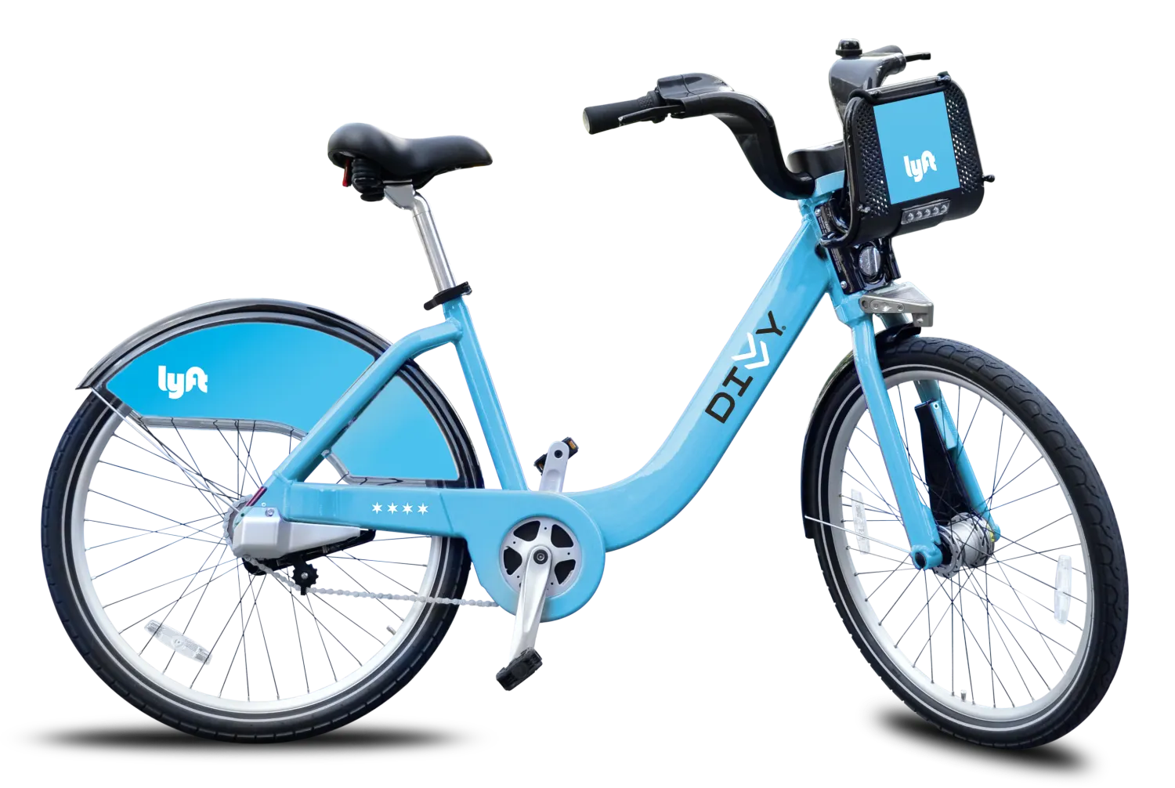
Convert Existing Cyclistic Casual Riders to
Annual Members
Cyclistic annual members have been found by Cyclistic’s finance analysts to be much more profitable than casual riders.
Goal: Discover how annual members and casual riders use Cyclistic bikes differently.
Requested by: Lily Moreno -
Cyclistic Director of Marketing
Research by: Thomas Purcell -
Cyclistic Analytics Team
08/29/2022

Slide 2
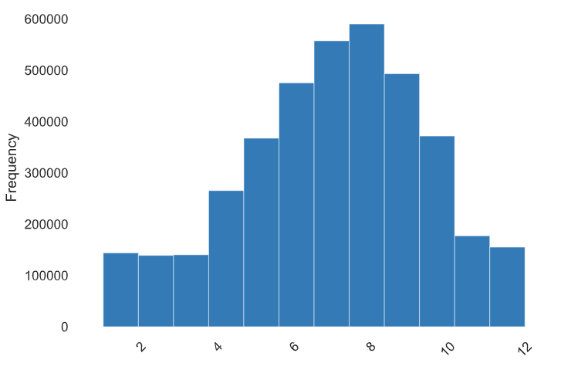
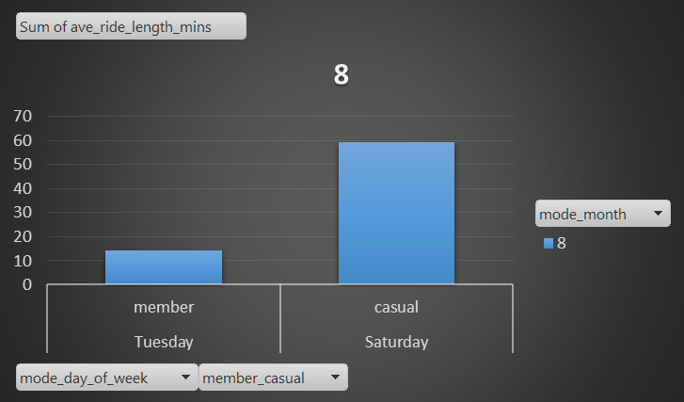
We now know how Members/Casuals ride and utilize the service differently.
Other important insights have been observed and will be presented last. Of these more research is needed for a conclusion.
Facts:
30% of all riders use service to commute to work each day.
70% use bikes for casual rides.
Members are most active on a Tuesday in August while casual riders on Saturdays in August. This may indicate member use for commuting. Casual riders may be as before tourists and weekend locals. August is a popular month to take a summer vacation for many families.
- August as the all rider peak within the April-November distribution. -

Slide 3
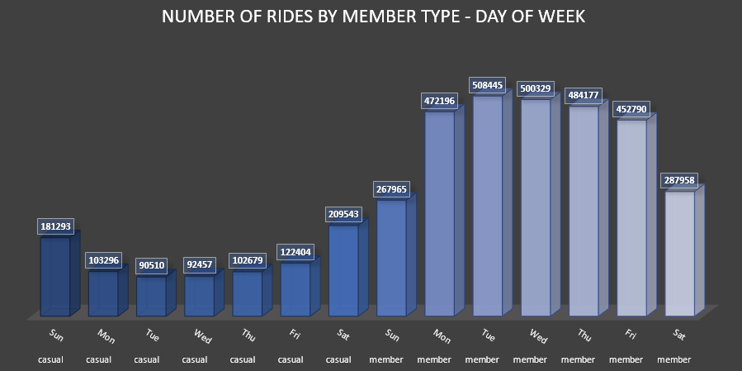
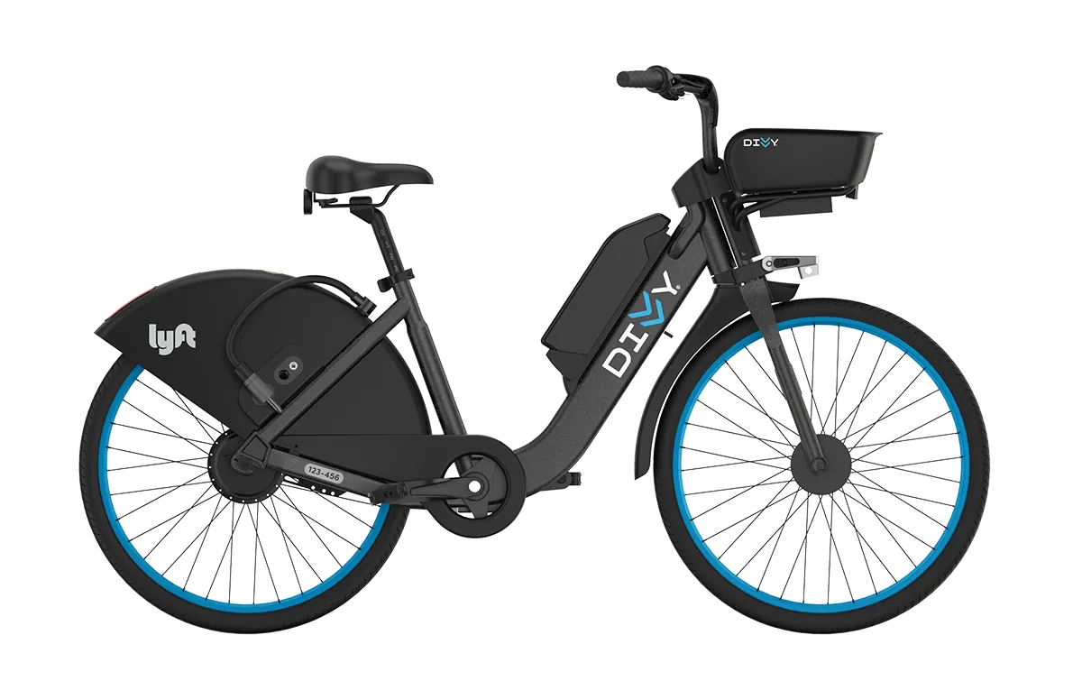
How do annual members and casual riders use Cyclistic bikes differently?
Case 1:
Members currently trend more rides than Casual riders with 508,445 rides on Tuesdays. These riders are likely commuters.
Casual riders trend 209,543 rides on Saturdays.
Likely weekend
focused riders.

Slide 4
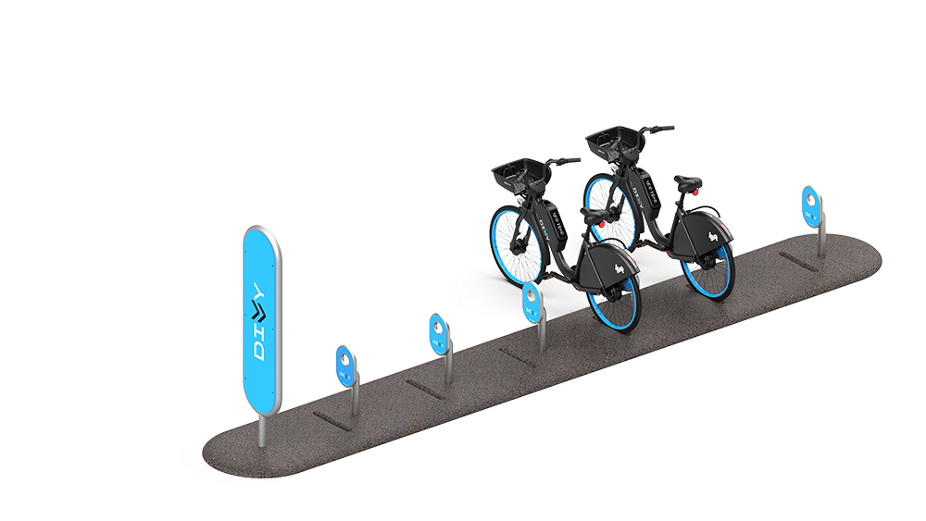
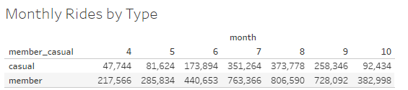
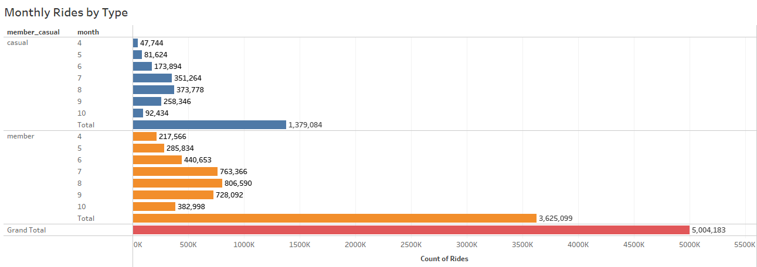
The second case describing rider type differences.
Casual riders trend 373,778 rides during August. Total for the 7 mth period is 1,379,084 rides.
Members currently trend more rides than Casual riders with 806,590 rides in August. Total for the period is 3,625,099 rides.

Slide 5
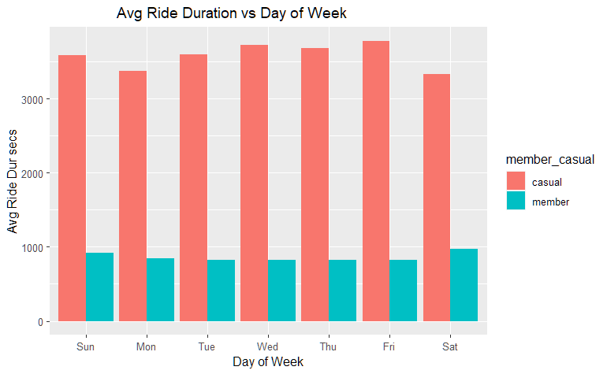
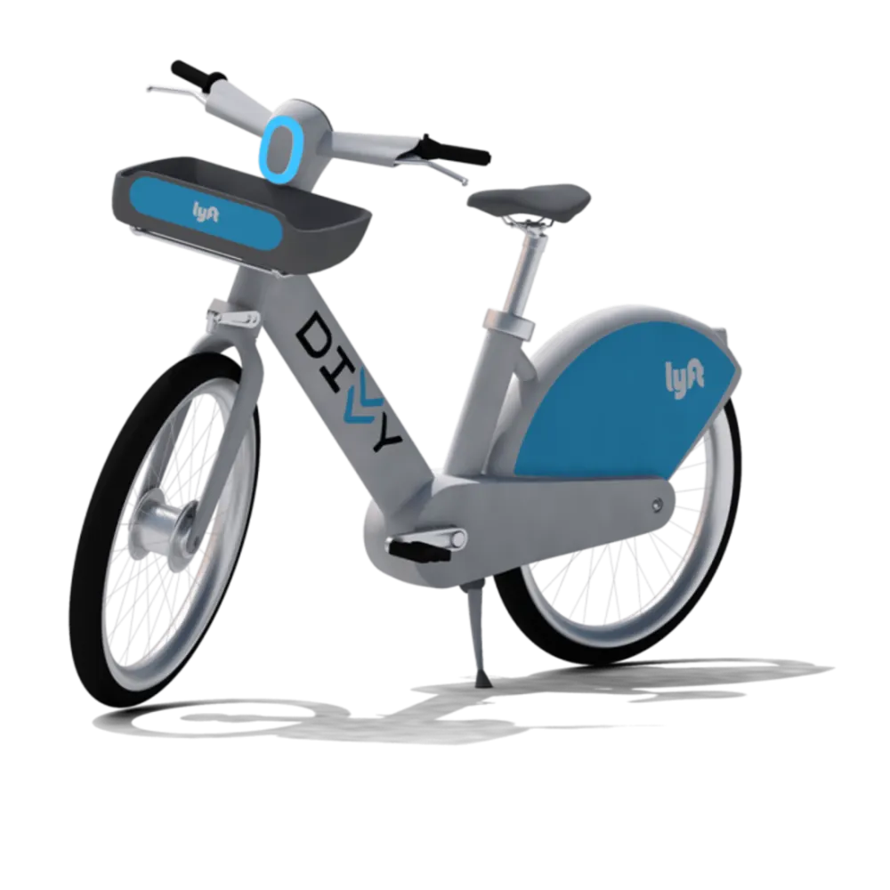
The third case describing rider type differences.
Casual riders trend significantly higher average ride lengths than Members everyday of the week for the period.
Certainly a factor in profitability of members over casual.

Slide 6

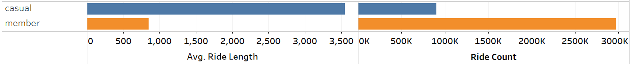
The fourth case describing rider type differences.
Finally in regards to the member use differences the ride count vs ride length by member type shows a stark comparison.
Members average ride count for the year registered 2,973,860 rides.
The casual riders registered 902,182 rides in total.
Ride Count vs Ride Length by Type -

Slide 7
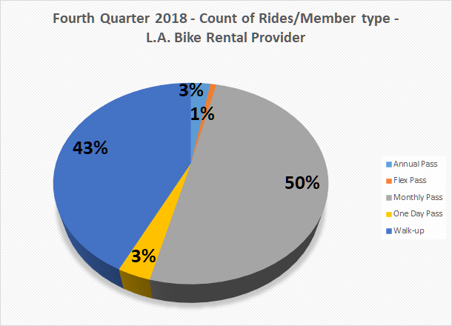
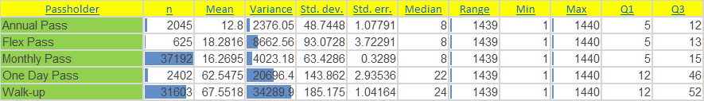
A quick look at a bike-share company in LA whose Annual pass riders took less than 3% of all trips annually.
The L.A. company monthly and walk-up groups took 50% and 43% of trips each annually.
These metrics tell us here in Chicago that either the bikeshare business is profitable for non member types or it could be the fact that LA has better year round weather and therefore different usage patterns.
LA is also a popular tourist destination which explains many of the walkup rides. One day and Flex passes are candidates for upsizing though discounts may be in order to pursue this. The monthly pass is likely a steady user type who is a prime candidate for Membership upsizing promotions.

Slide 8
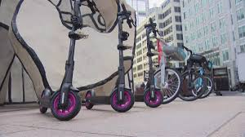
Design a new marketing strategy to convert casual riders into annual members based on approved findings.
Given that the upsizing population is the current casual rider base, various promotional discounts should be offered via code on ride start or end.
Offering membership trials informed by rider interests and prior ride routes as features of the plan.
Offer significant discount for prepaying Annually for new Members.
Create Member Only events.
Offer VIP access at concerts or other large events.
How digital media could have a meaningful and positive effect?
Google Ads can be utilized to reach segments by region and other metrics. From there targeted web searches for “bike rental”, “bikes Chicago” and “electric bikes” will show ads depending on the granularity of the Ad campaign.
Marketing strategies can be determined using Google Analytics for online trends of rental bike searchers for a given town/time/sector.

